Slide 1
Iron Out the Kinks
Create Tools to Automate Rendering 3D Models of Marine Microbes from 2D Cross-sections
With Aaron A. Heiss
Hack the Deep 2018

Slide 2
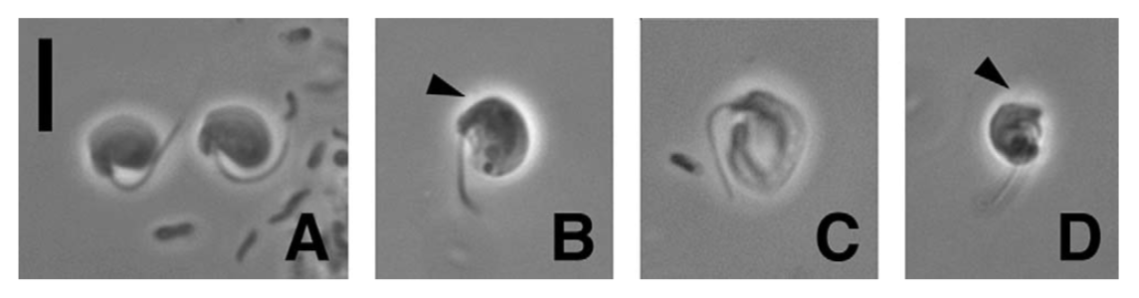
Phase-contrast light micrographs of live cells of Ancyromonas sigmoides

Slide 3
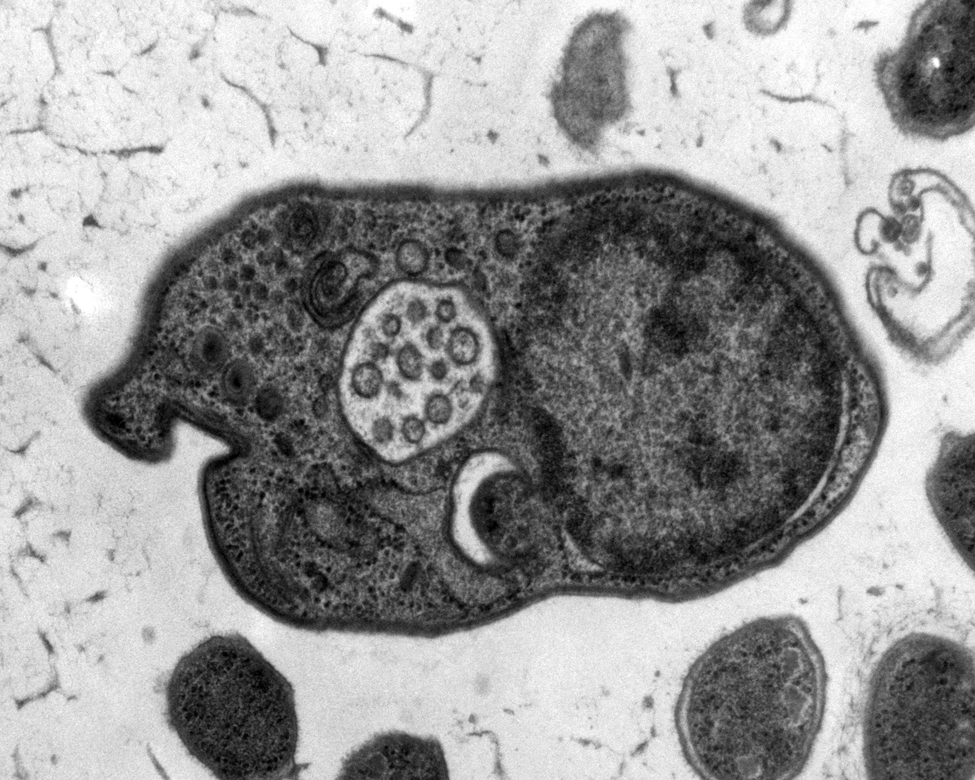
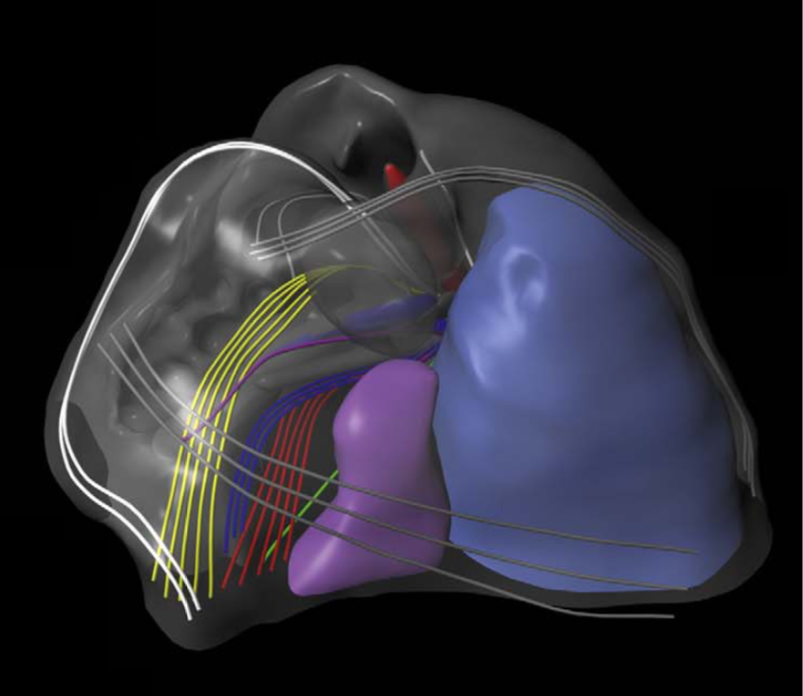
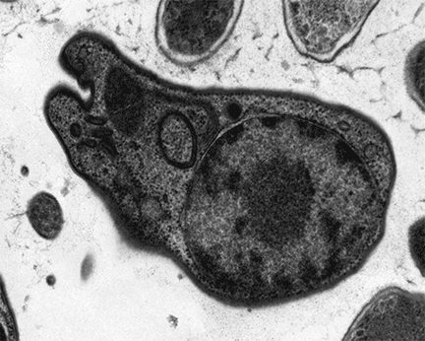
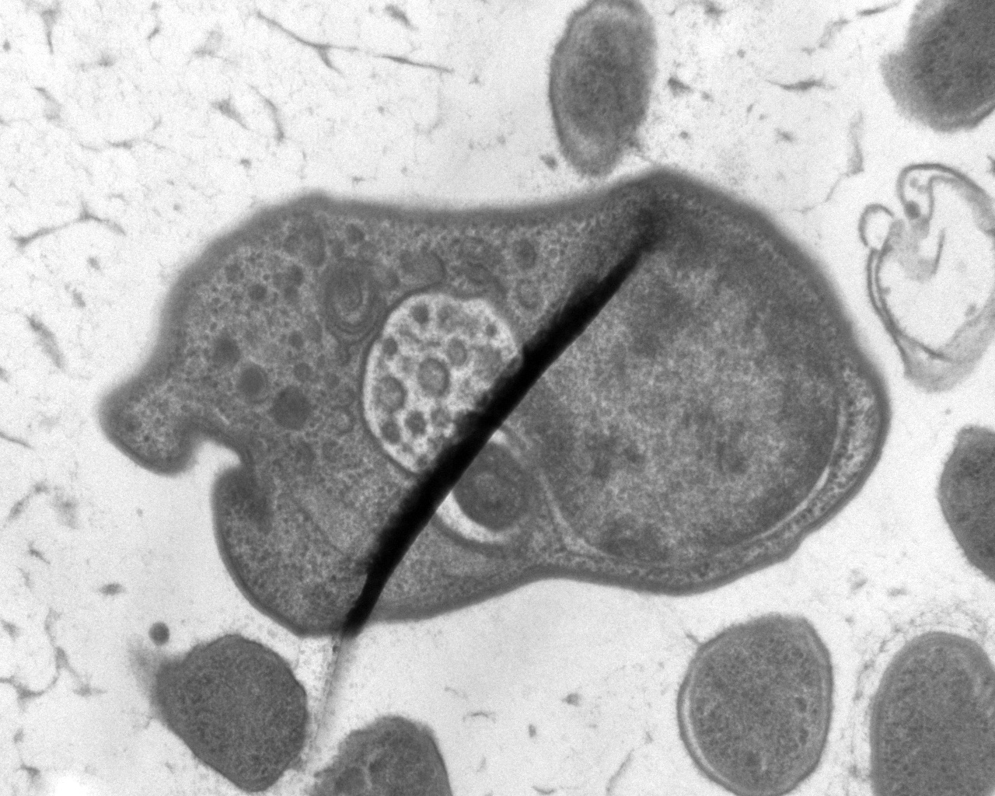
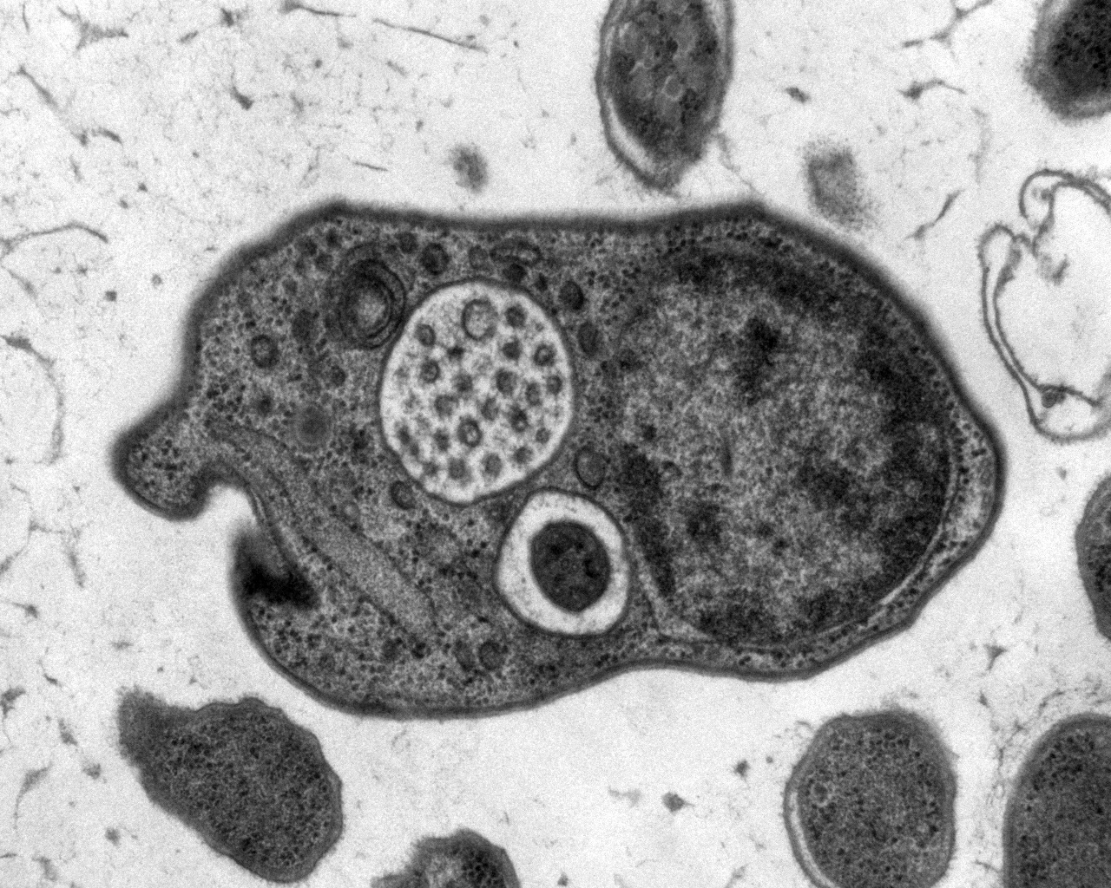
2D Slices -> 3D Model

Slide 4



Technologies

Slide 5
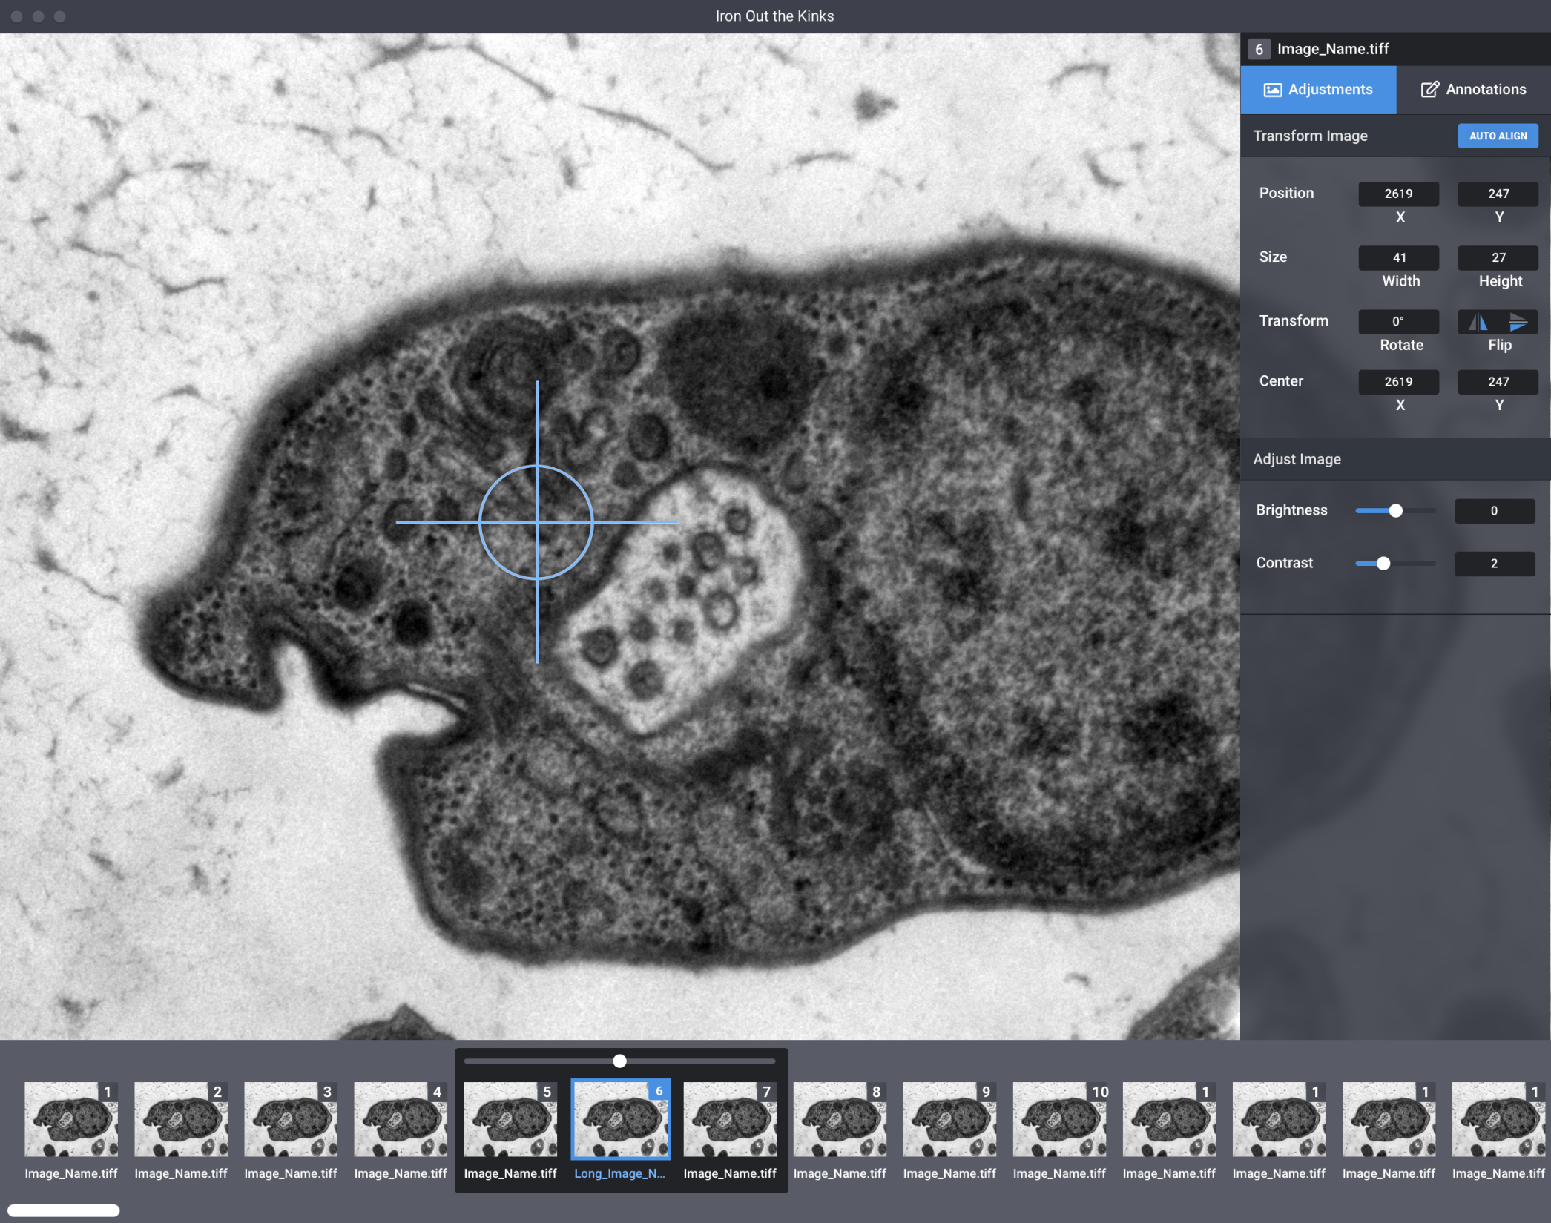
Design: Image Adjustments

Slide 6
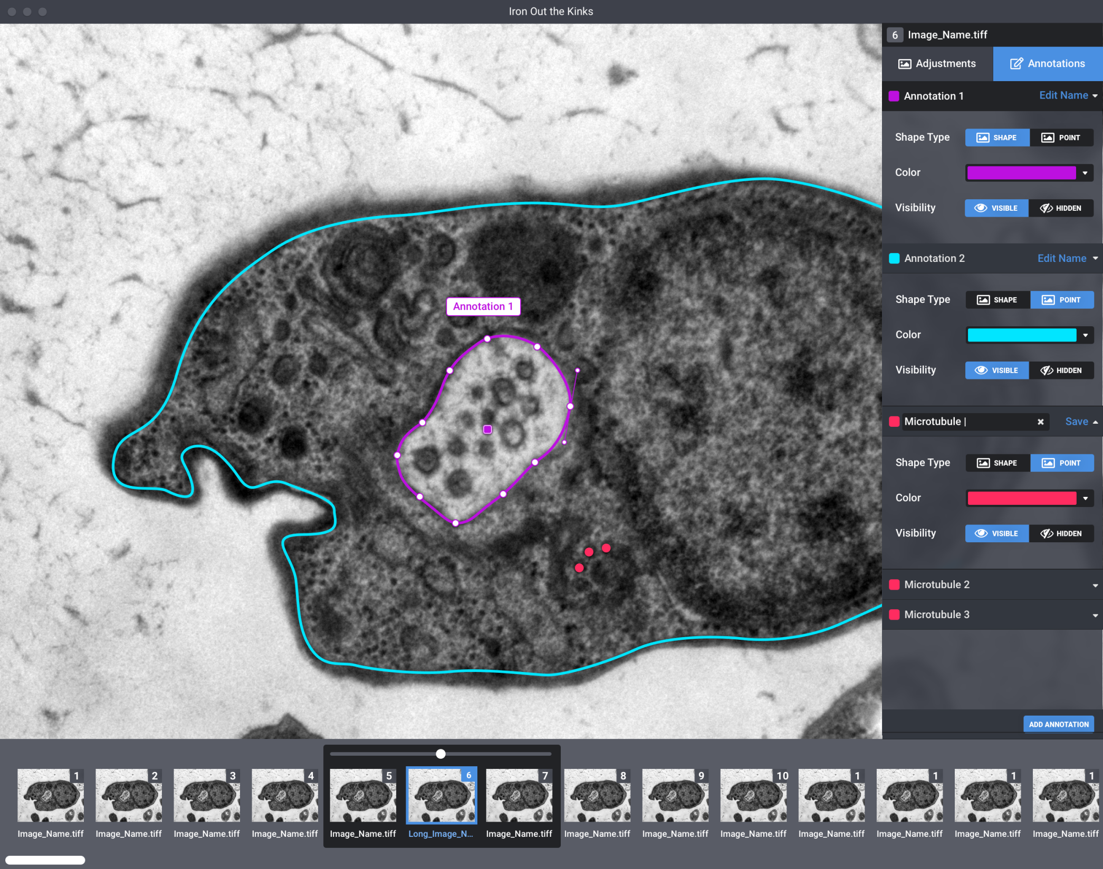
Design: Image Annotations

Slide 7
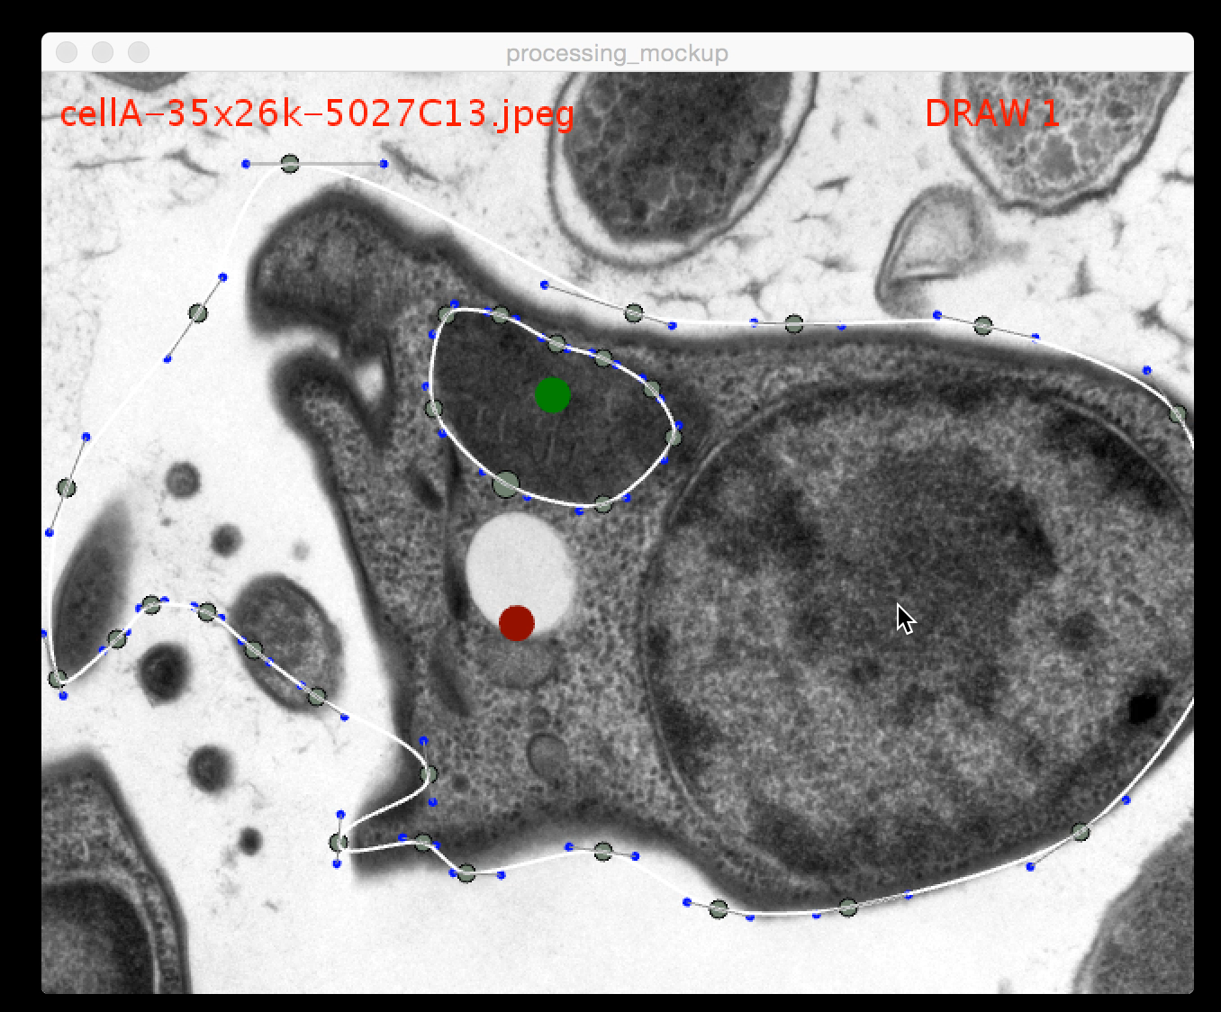
Electron UI: Draw & Edit Curves

Slide 8
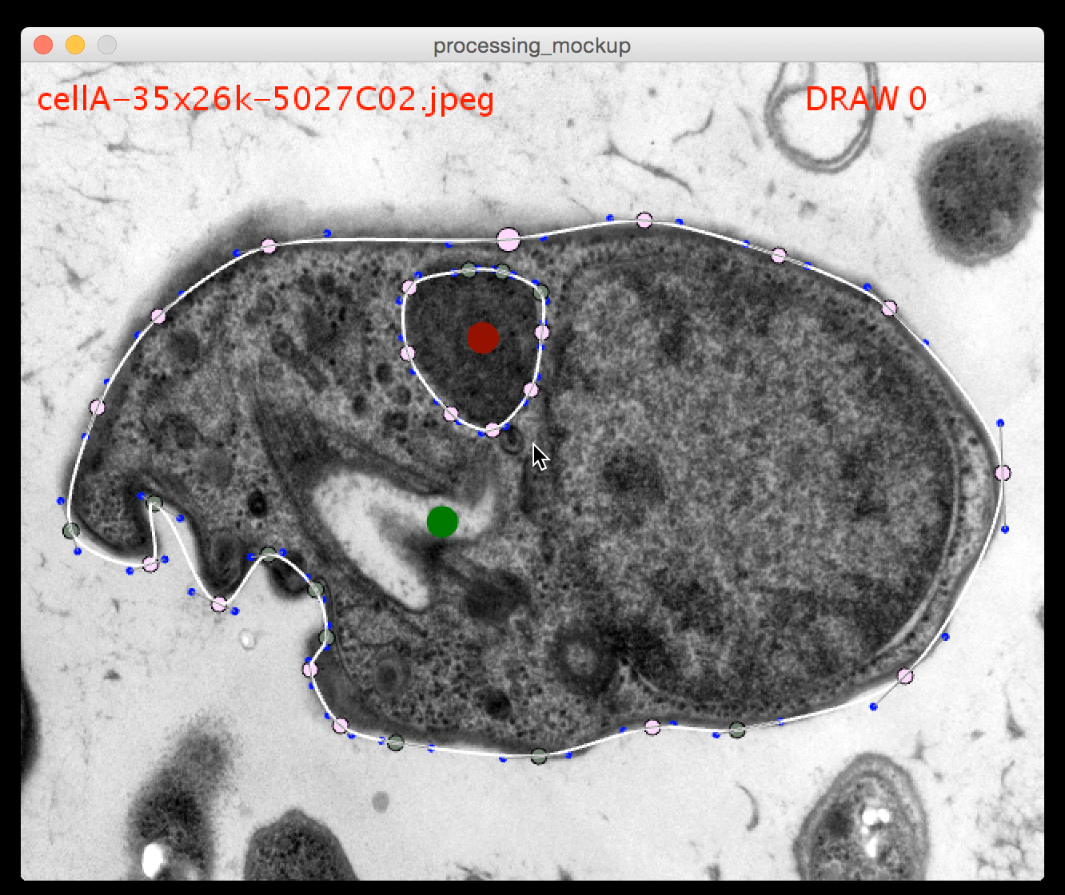
Interpolation Through Artefacts

Slide 9
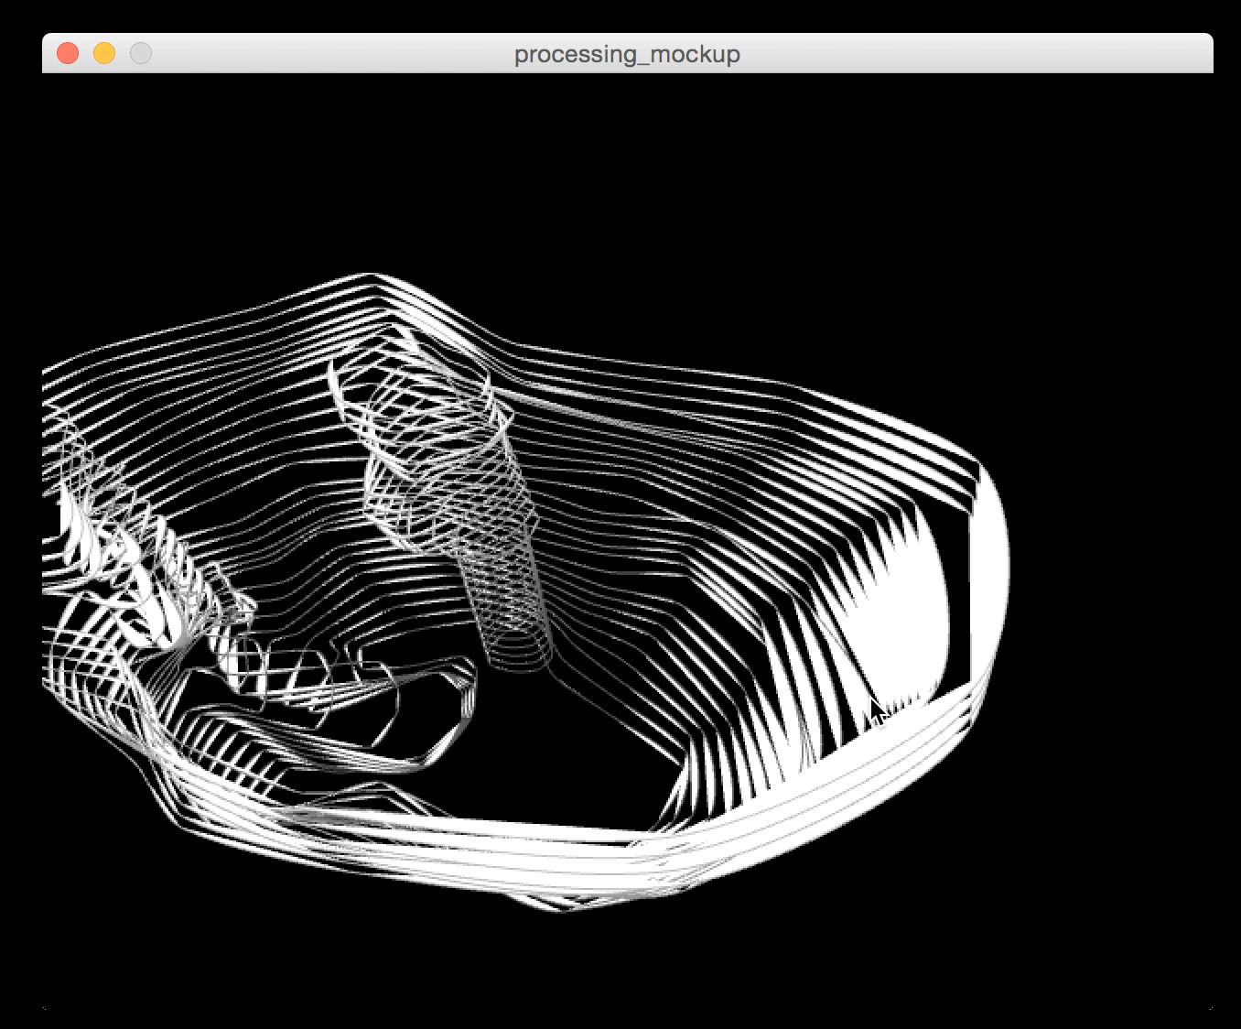
Preview in 3D

Slide 10

Export

Slide 11
More to come…
Auto Alignment / Stabilization using OpenCV
Use tracing libraries to assist
Lofting (adding surface over curves)
Shading / Tagging

Slide 12
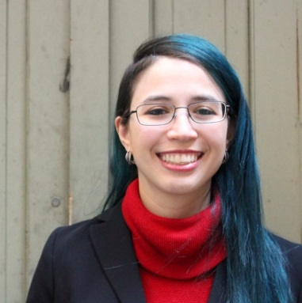
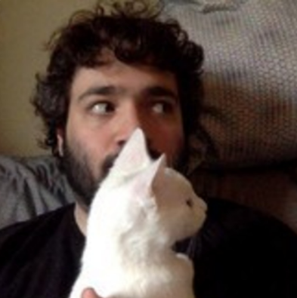

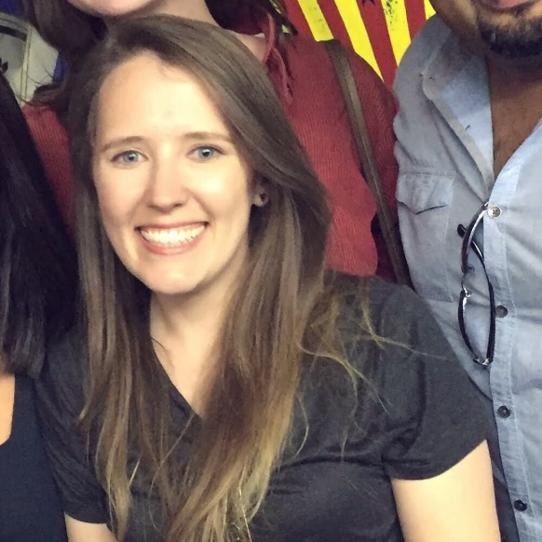
https://github.com/HackTheDeep/teamgoop
Jennifer Neale
Jesse Spielman
Abe Peterkin
Meret Götschel
Notes:
Credits: Aaron A. Heiss

